Slide 1
UI PROJECT DEVELOPMENT
PROJECT : DREAM-BENZ ( Product Based)
TEAM :2
T. MAHENDRA
B. NAGA DIVYA
B. VIJAY KUMAR

Slide 2
Technologies learnt :
HTML5 (hyper text mark up language)
CSS3 (Cascading style sheet)
MEDIA QUAIRES
JAVA SCRIPT
BOOTSTRAP

Slide 3
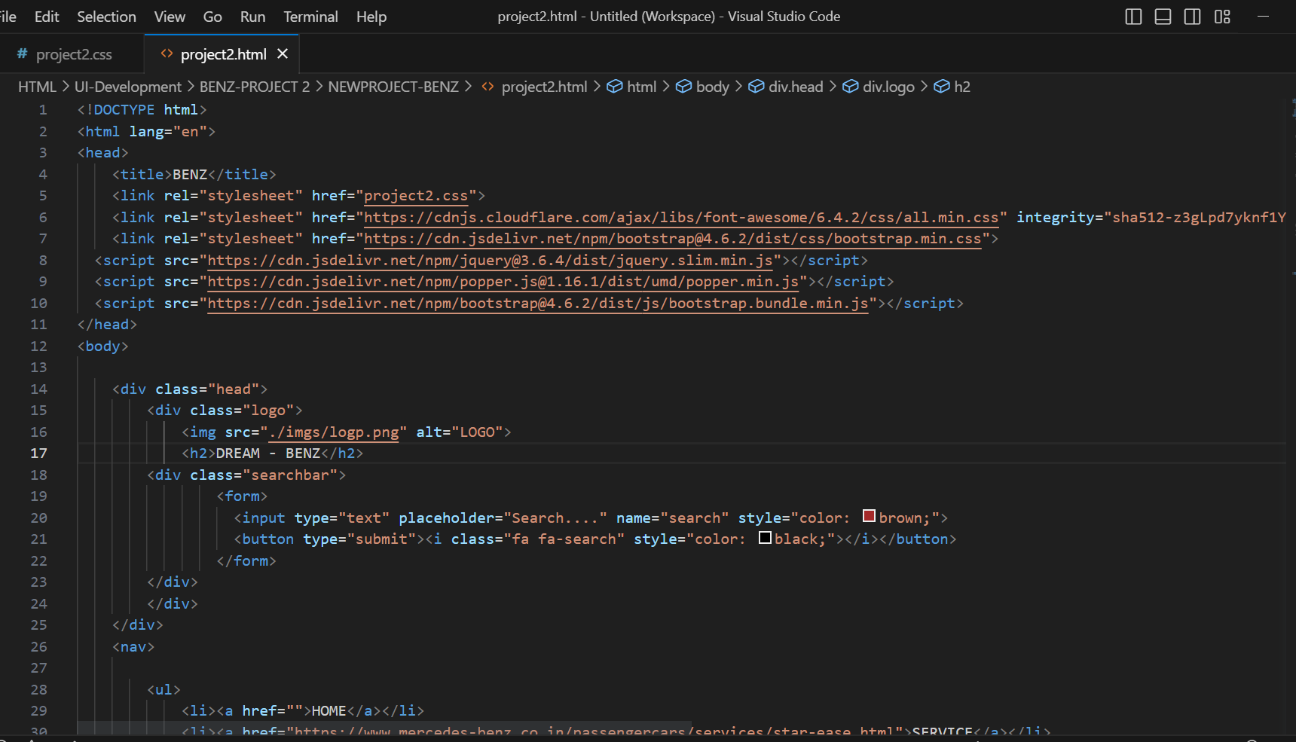
LandPage.html :
→This is the Main HTML Page

Slide 4
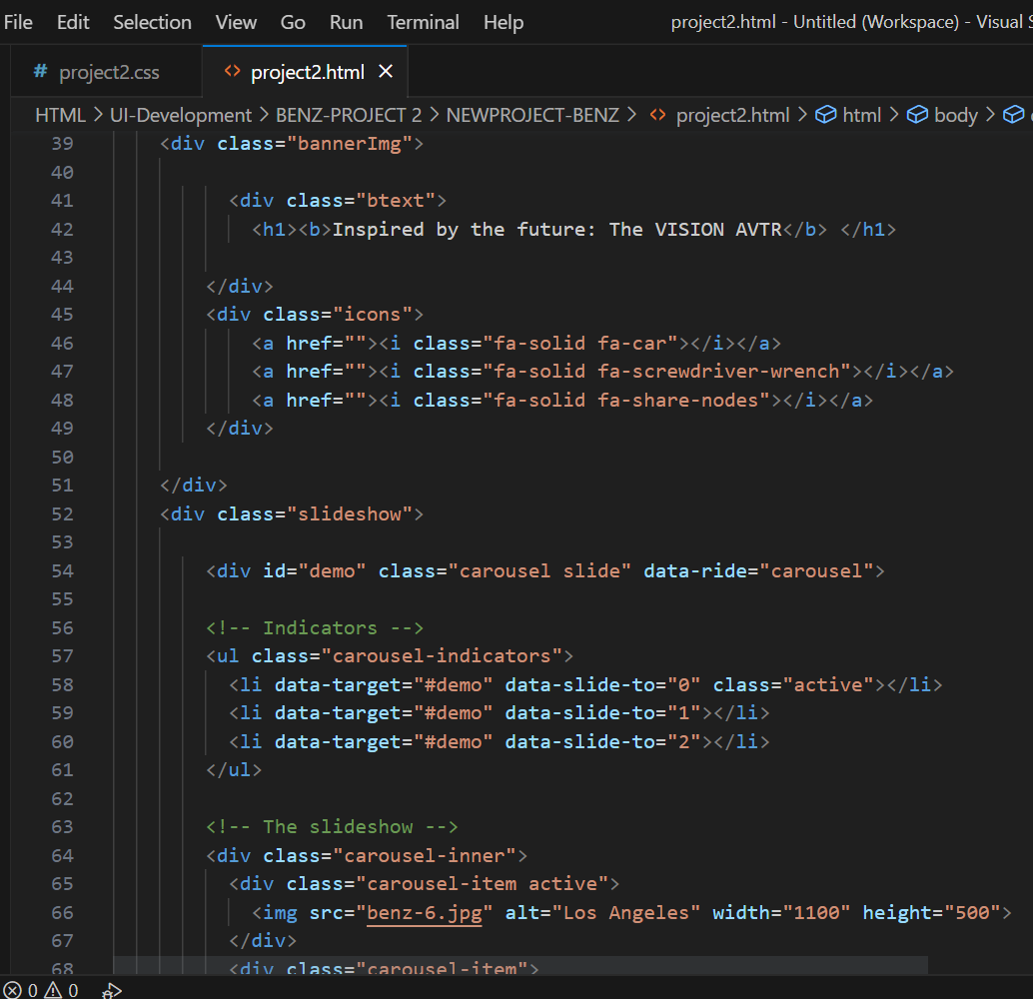
-

Slide 5
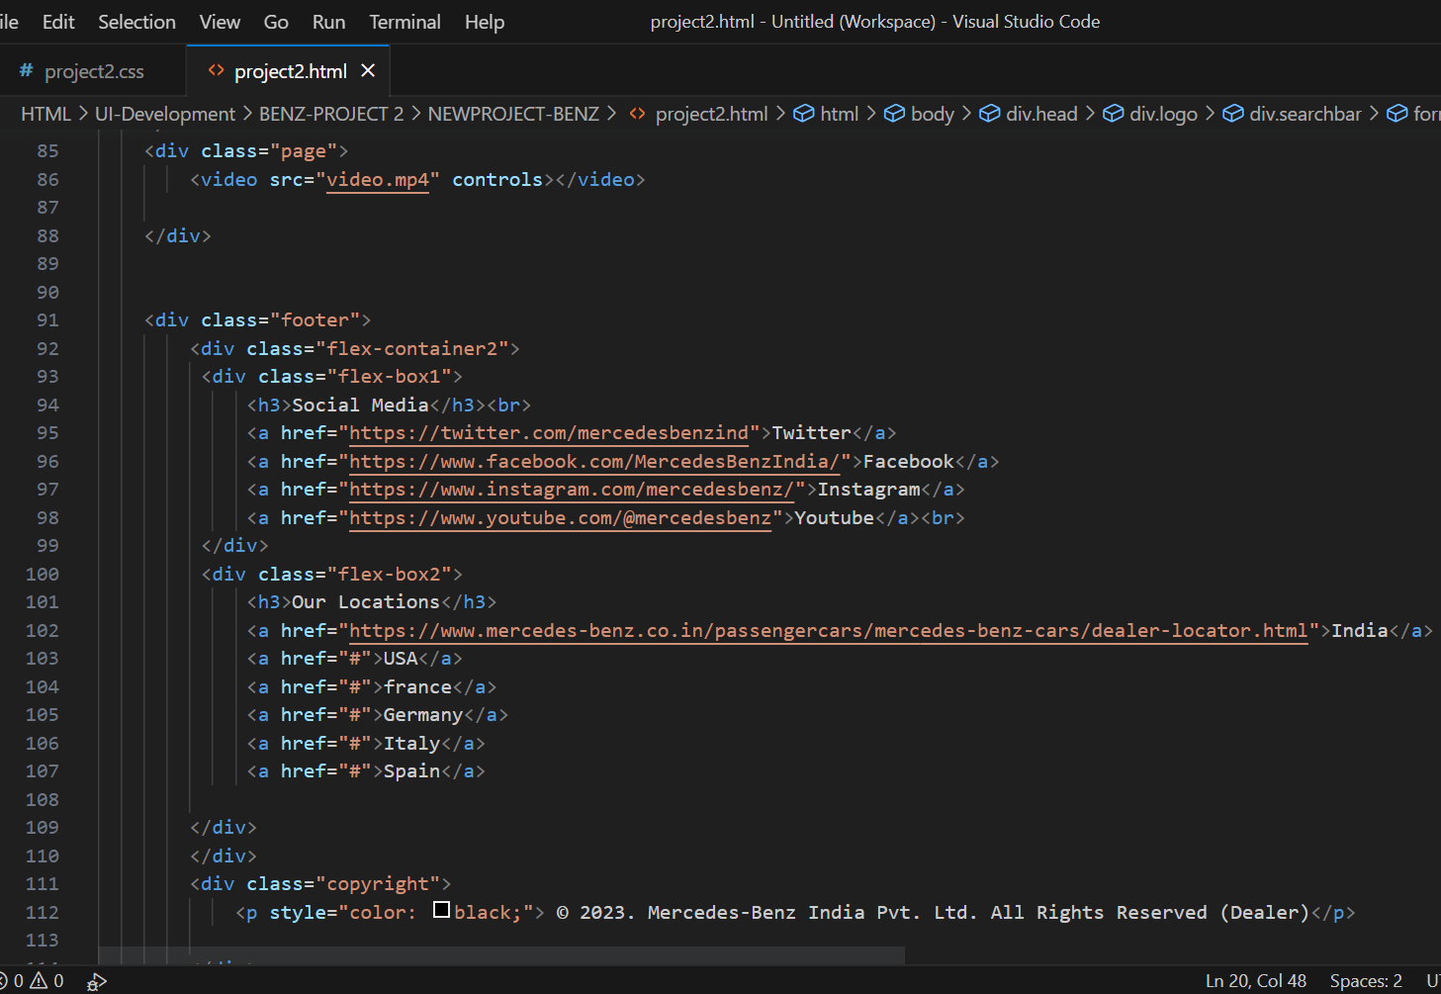
-

Slide 6
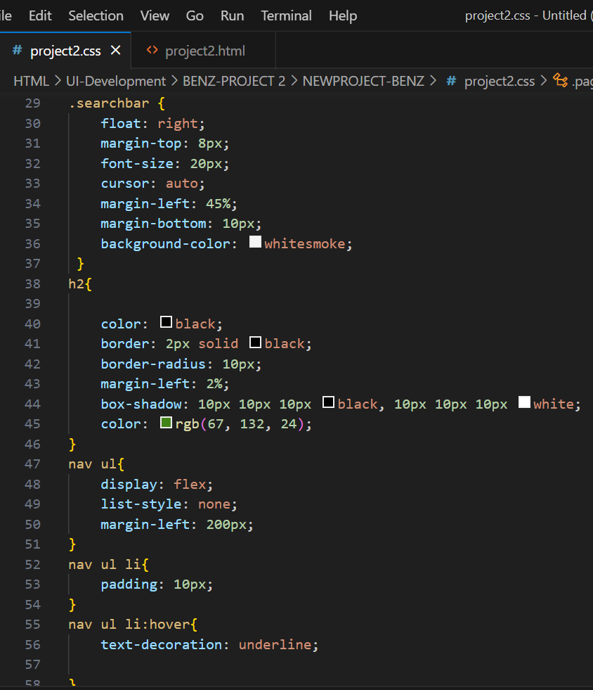
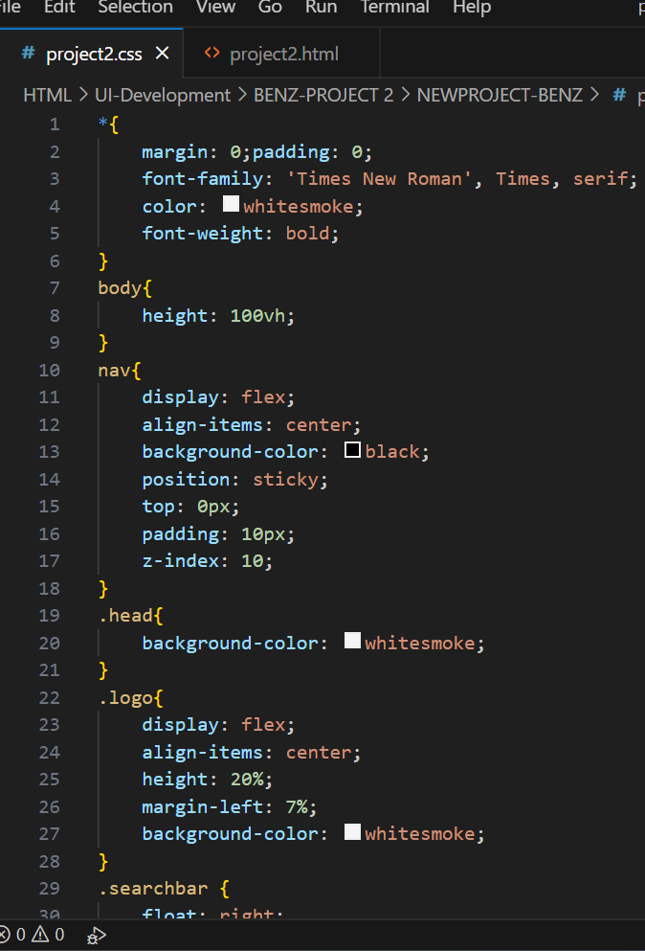
Landpage.css

Slide 7
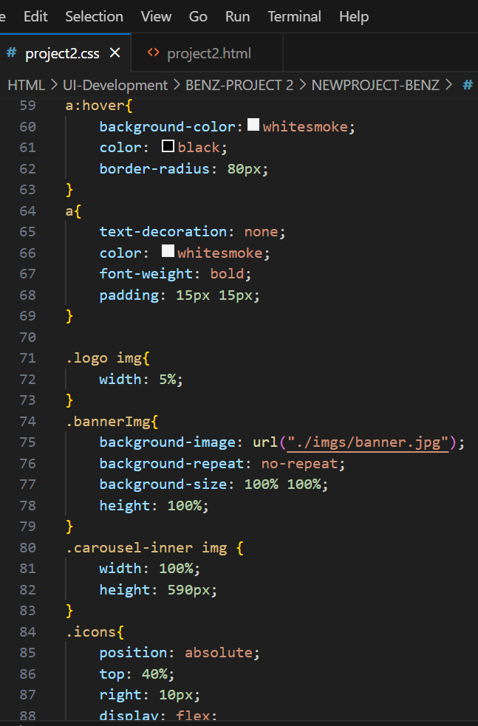
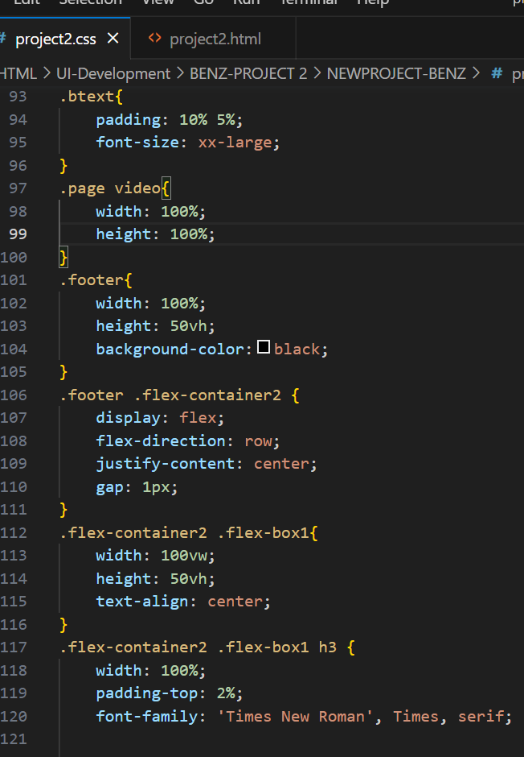
-

Slide 8
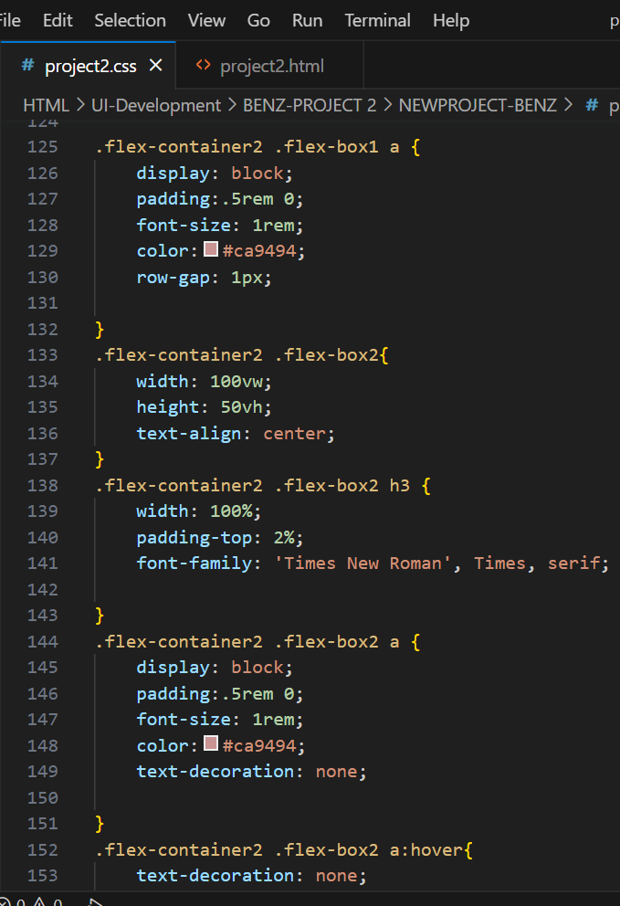
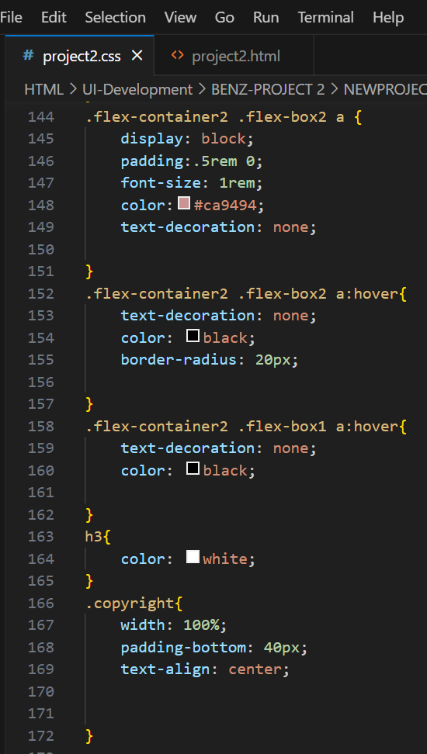
-

Slide 9
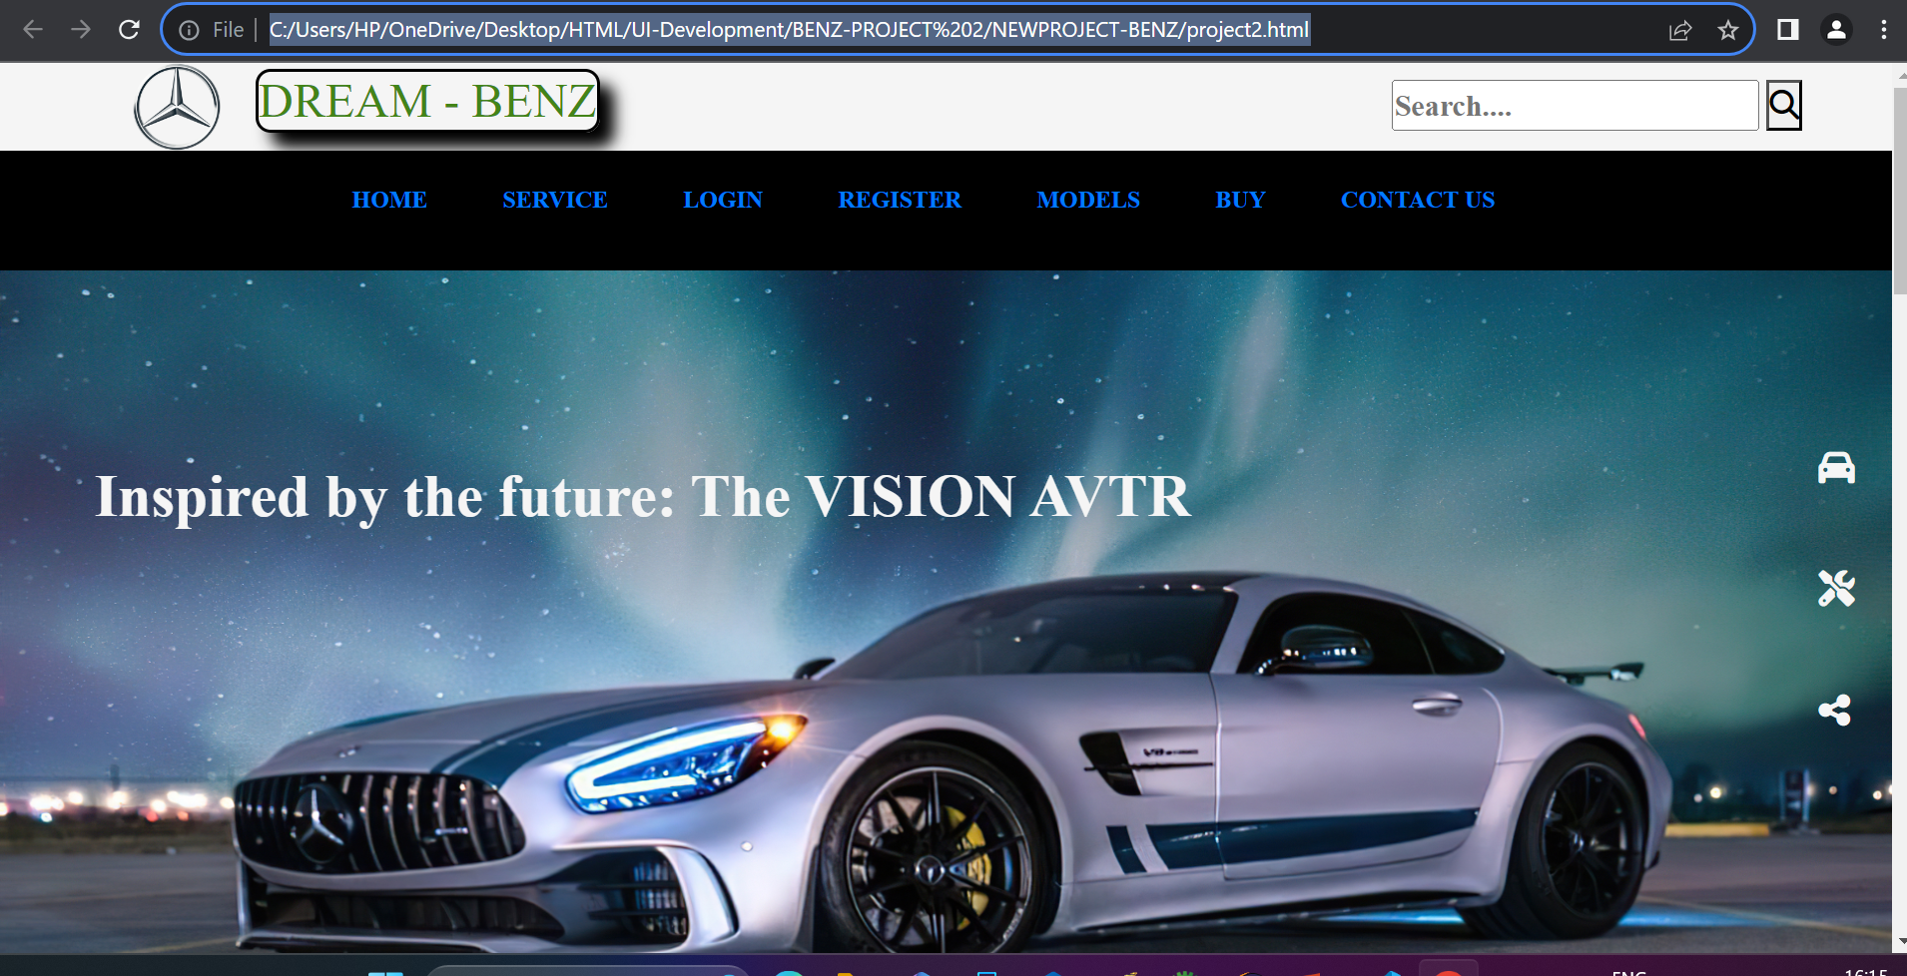
Output of landpage :

Slide 10
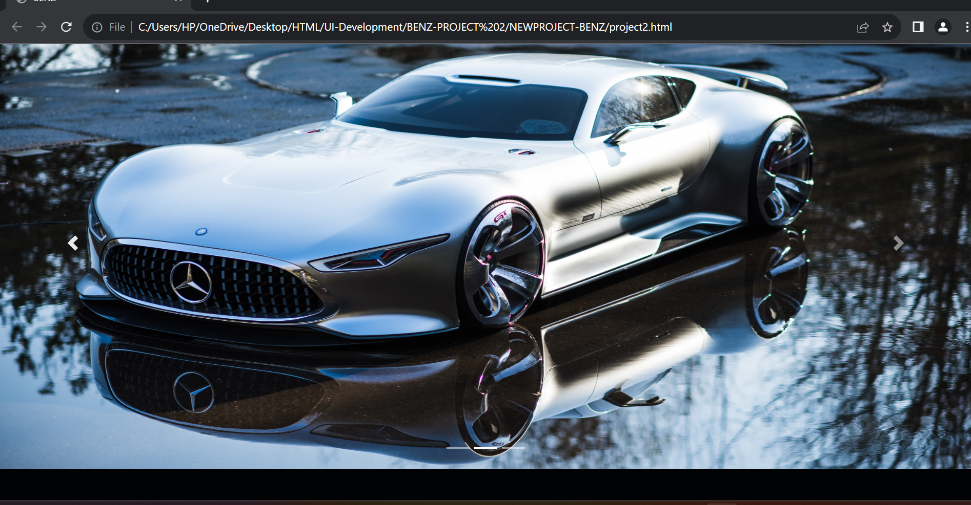
This is the courosel page:

Slide 11
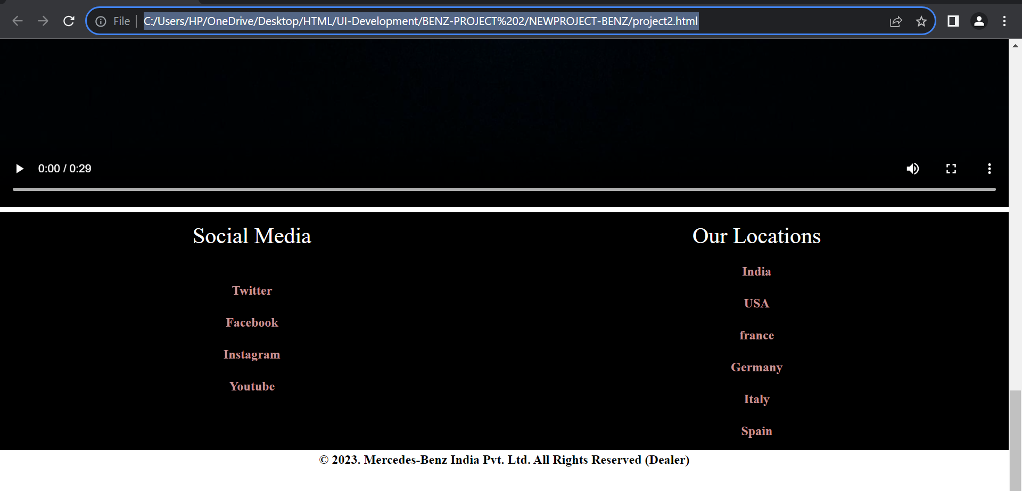
This is the footer page:

Slide 12
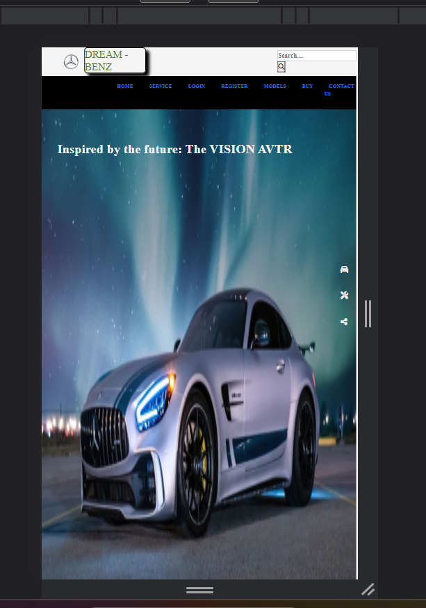
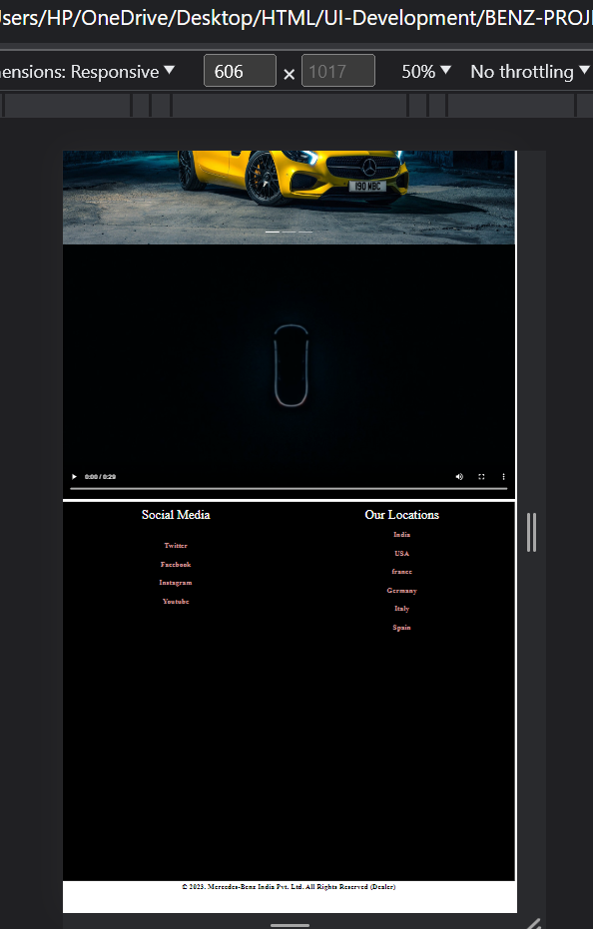
After adding media quires:
This is the output of Mobile view after adding media quires(Responsive web page):

Slide 13
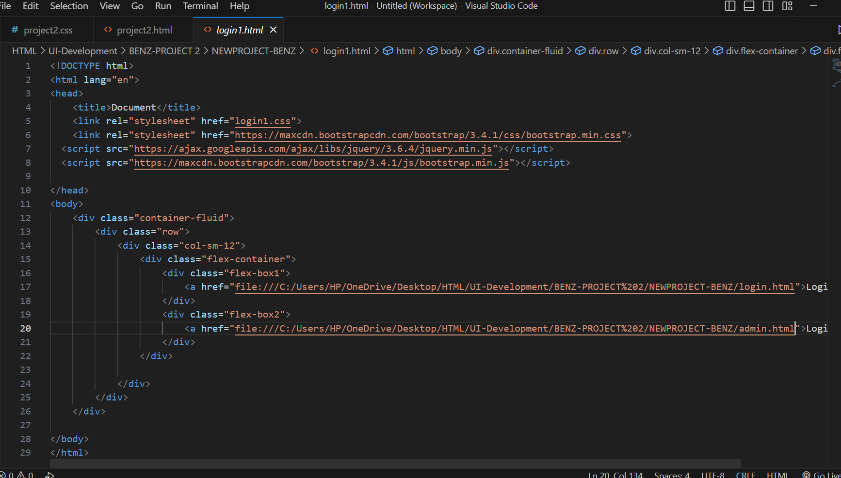
Login1.html:
In the above web page if we click on login it directs to this login page
Then there will be two options one as login as user and another one is login as admin:

Slide 14
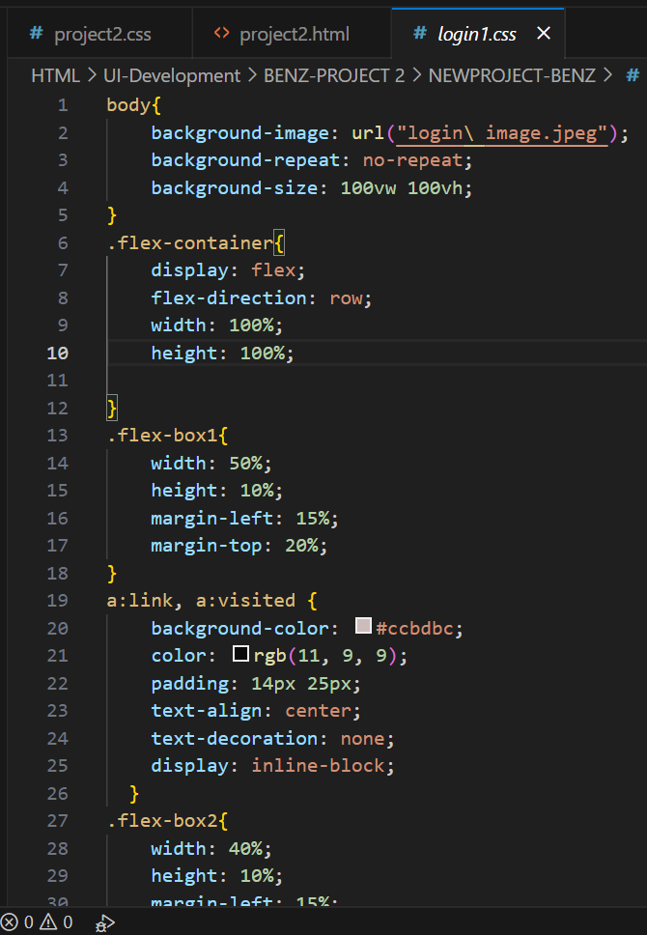
Login1.css:

Slide 15
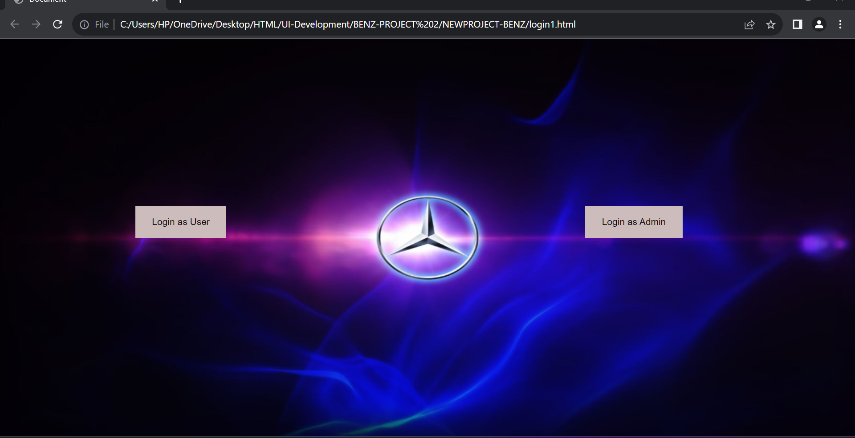
Output for Login1 page:

Slide 16
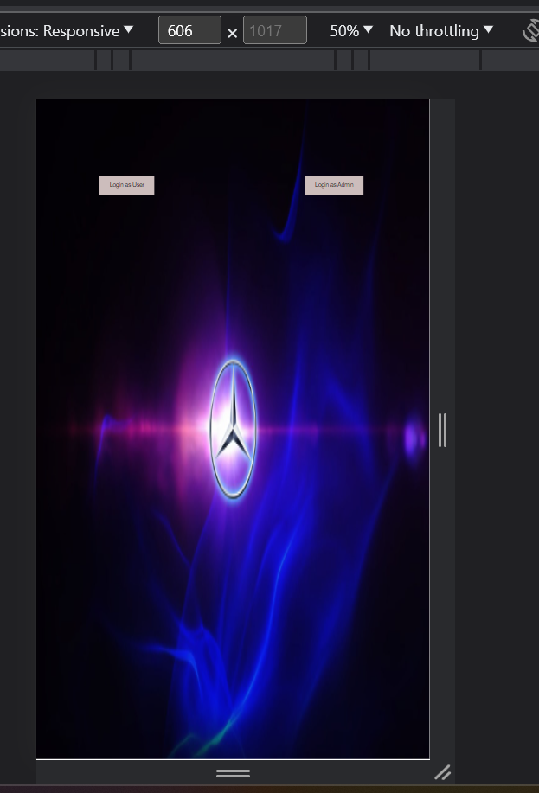
Responsive web page for Login1:
After applying Bootstrap This is the responsive page:

Slide 17
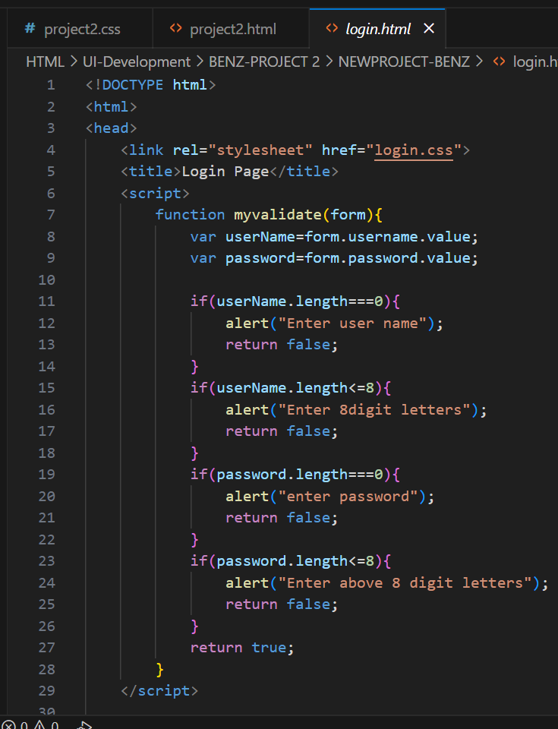
Loginpage.html
In the above Login1 form if we click on login as user it directs to this login page
Here, Below is the HTML Code for Login page :

Slide 18
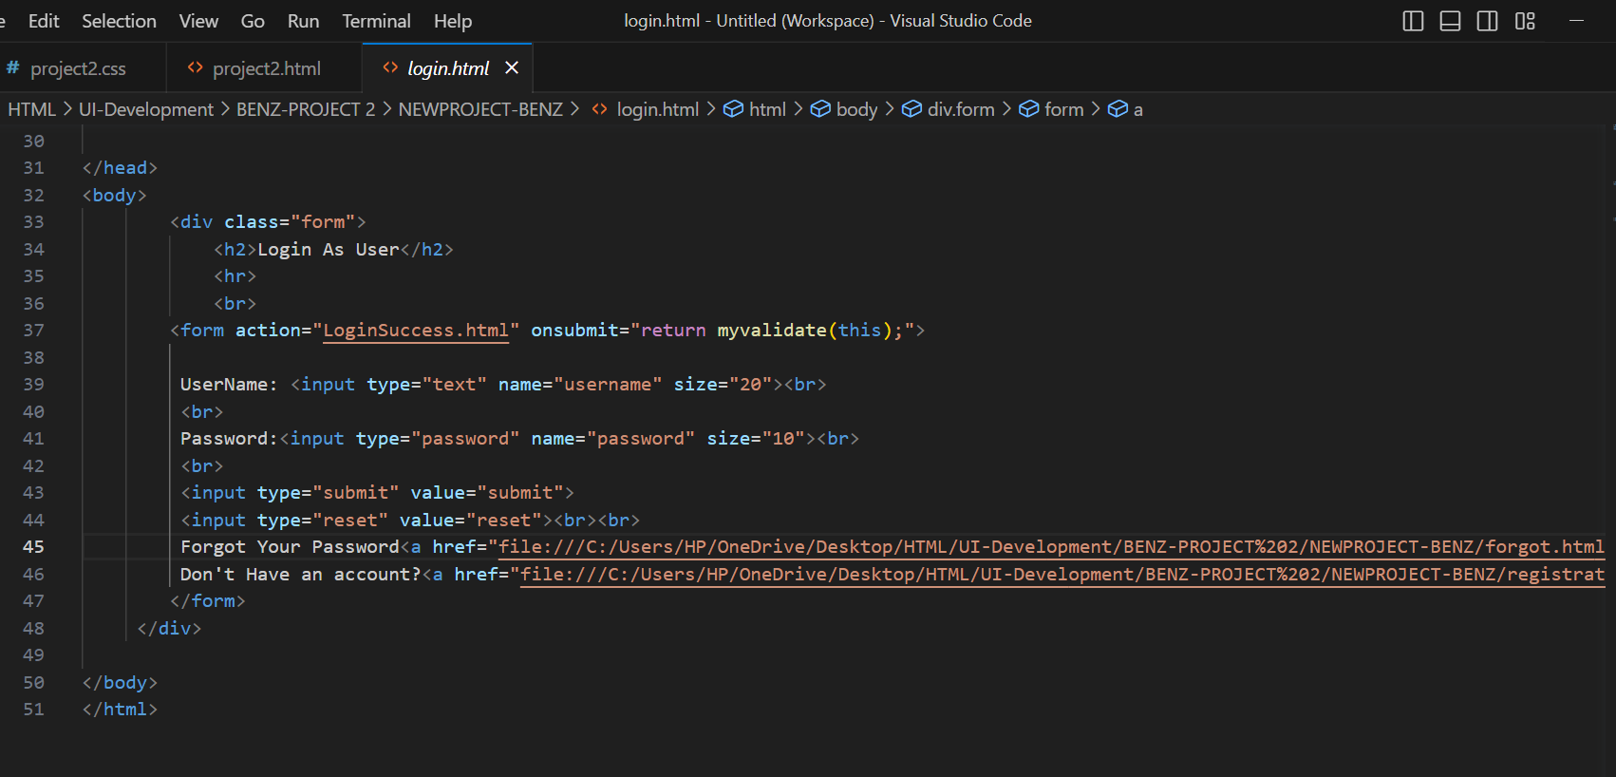
-

Slide 19
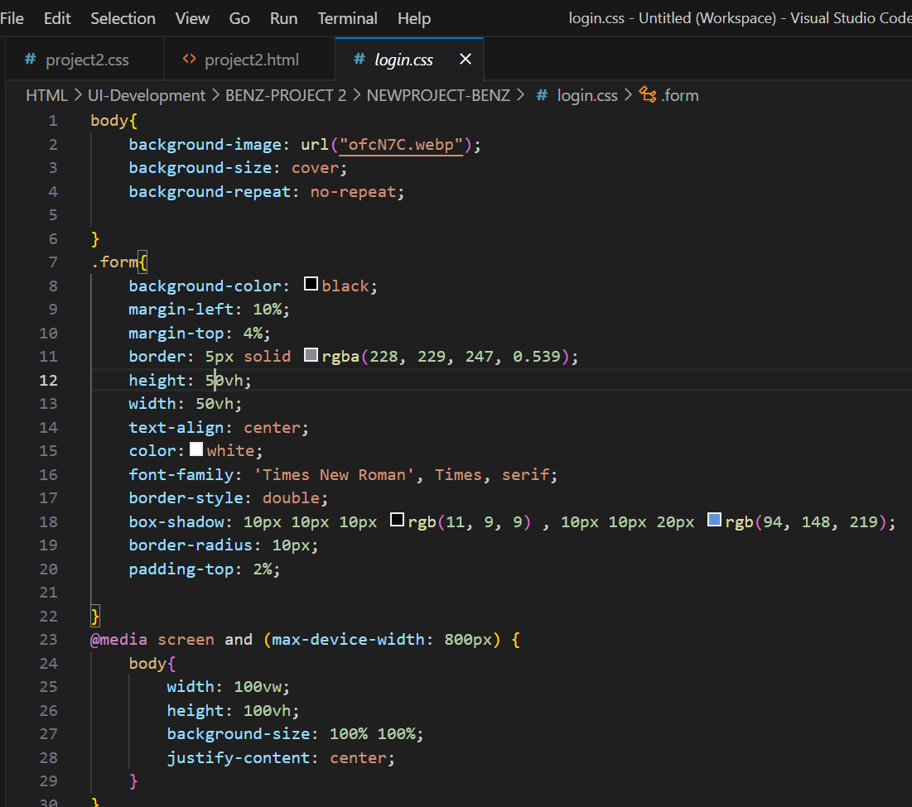
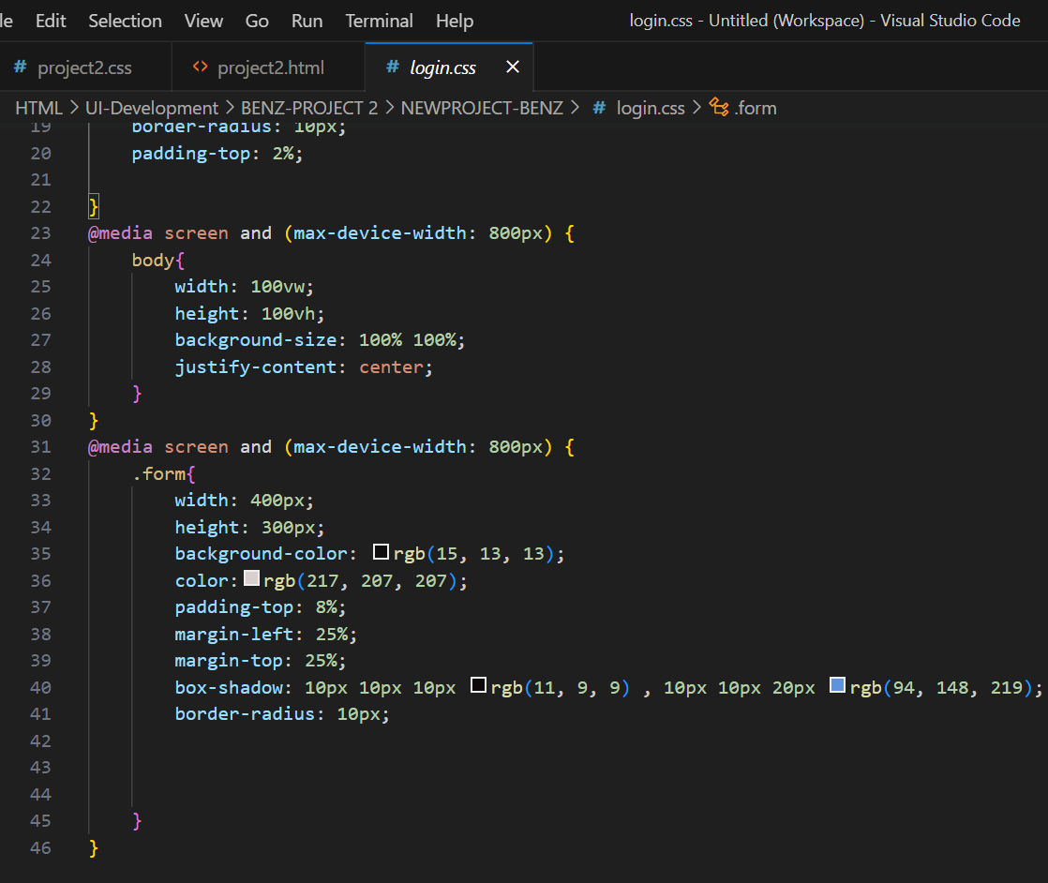
Loginpage.css

Slide 20
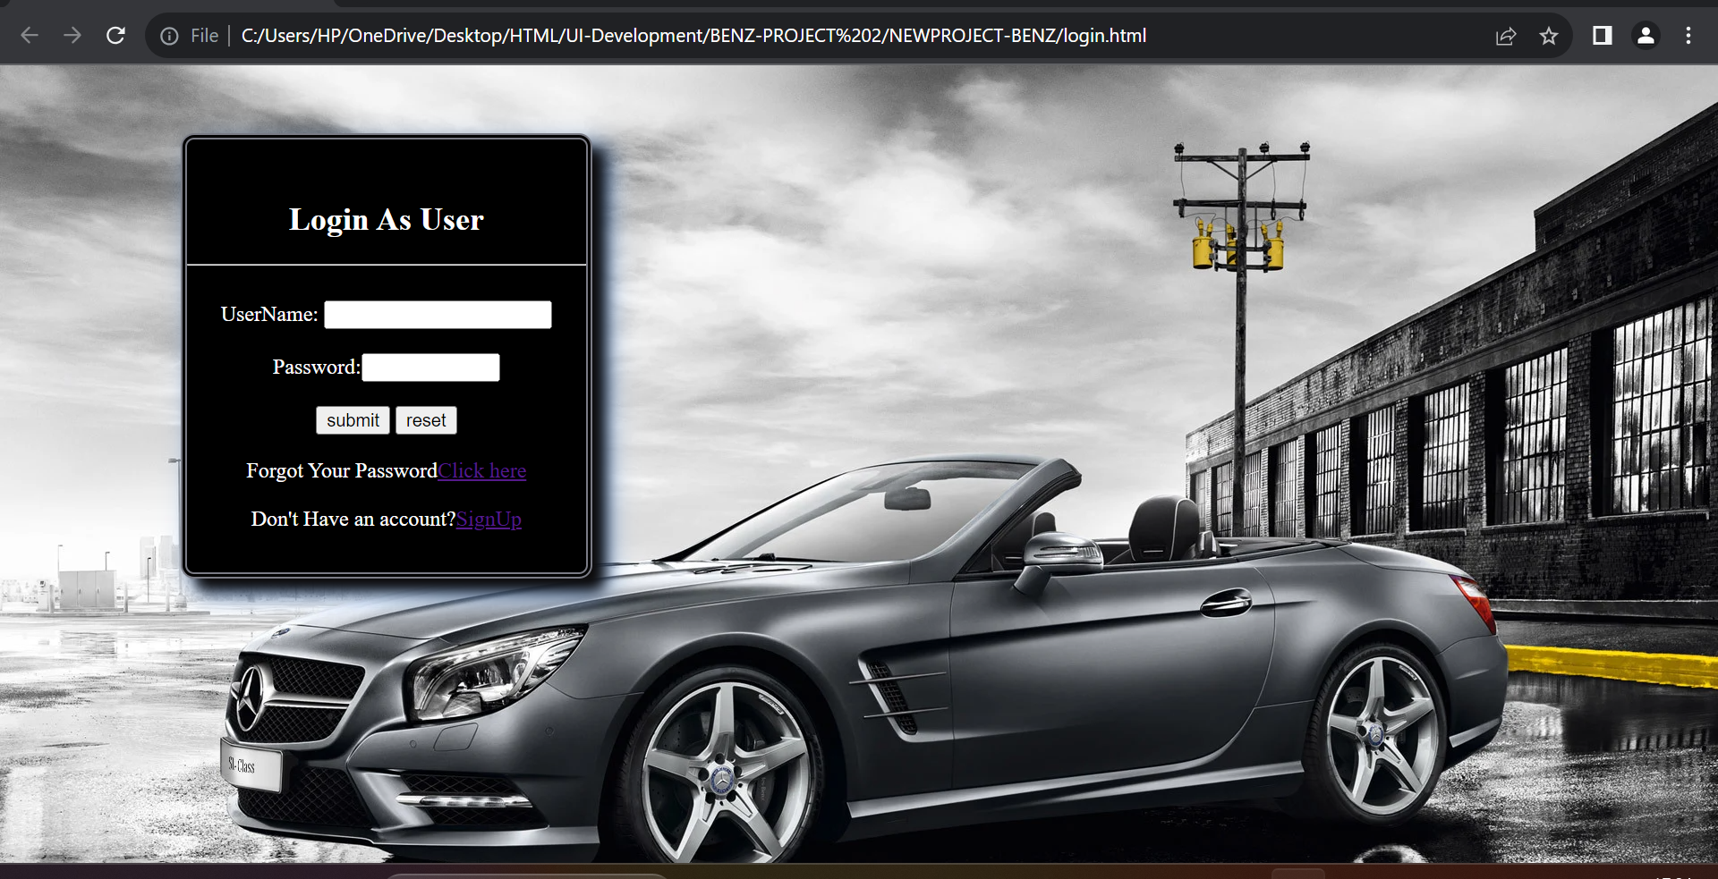
Out put :

Slide 21
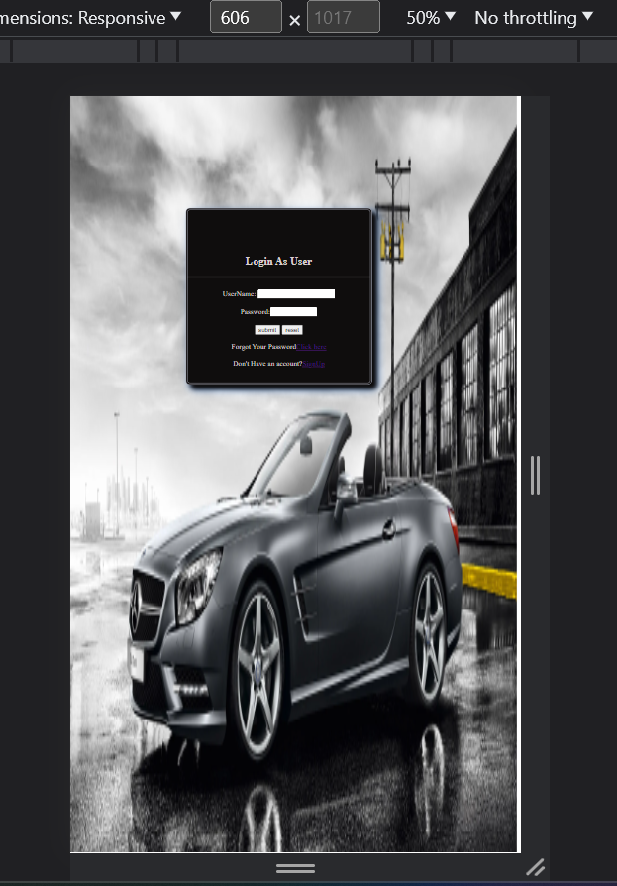
After adding Bootstrap:
This is the output of Mobile view after adding Bootstrap to login page:

Slide 22
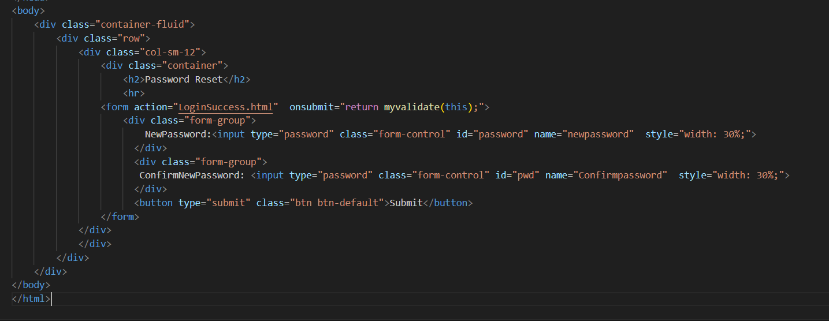
Forgot password html:
In the above web page if we click on Click here it directs to this forgot password page.
Here, Below is the HTML Code for forgot password page :

Slide 23
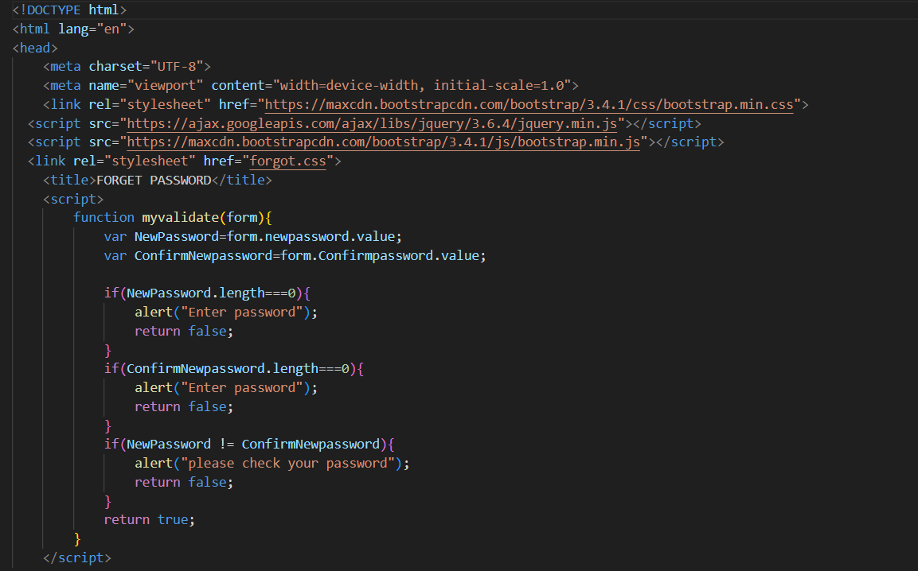
-
Here, Below is the javascript Code for forgot password page :

Slide 24
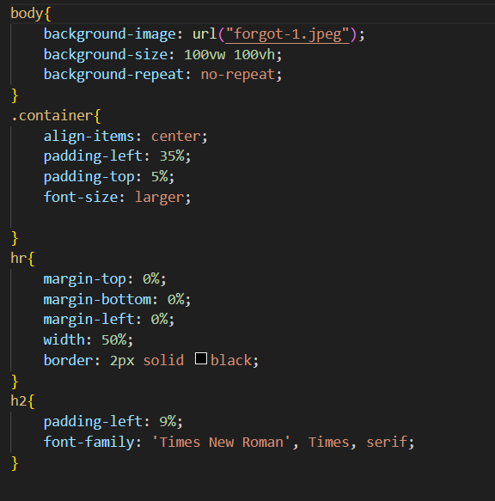
Css code:

Slide 25
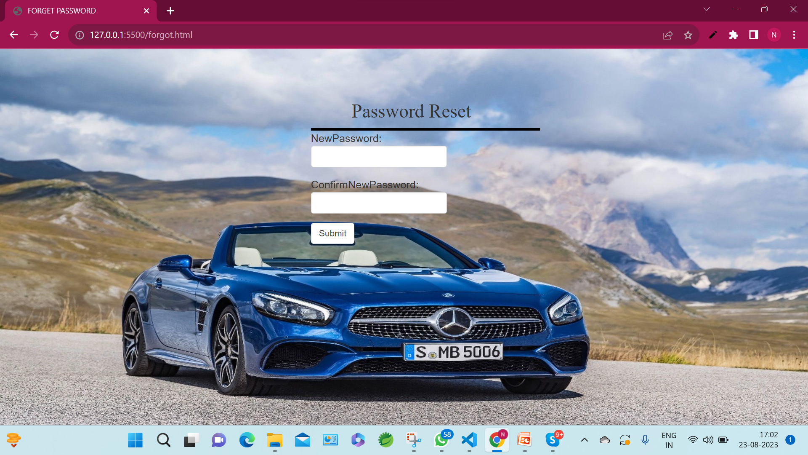
Output for forgot password page:

Slide 26
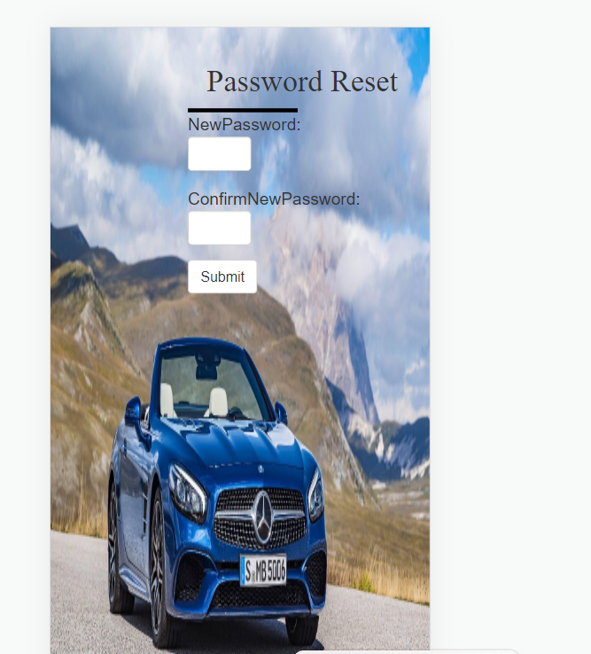
In mobile view:

Slide 27
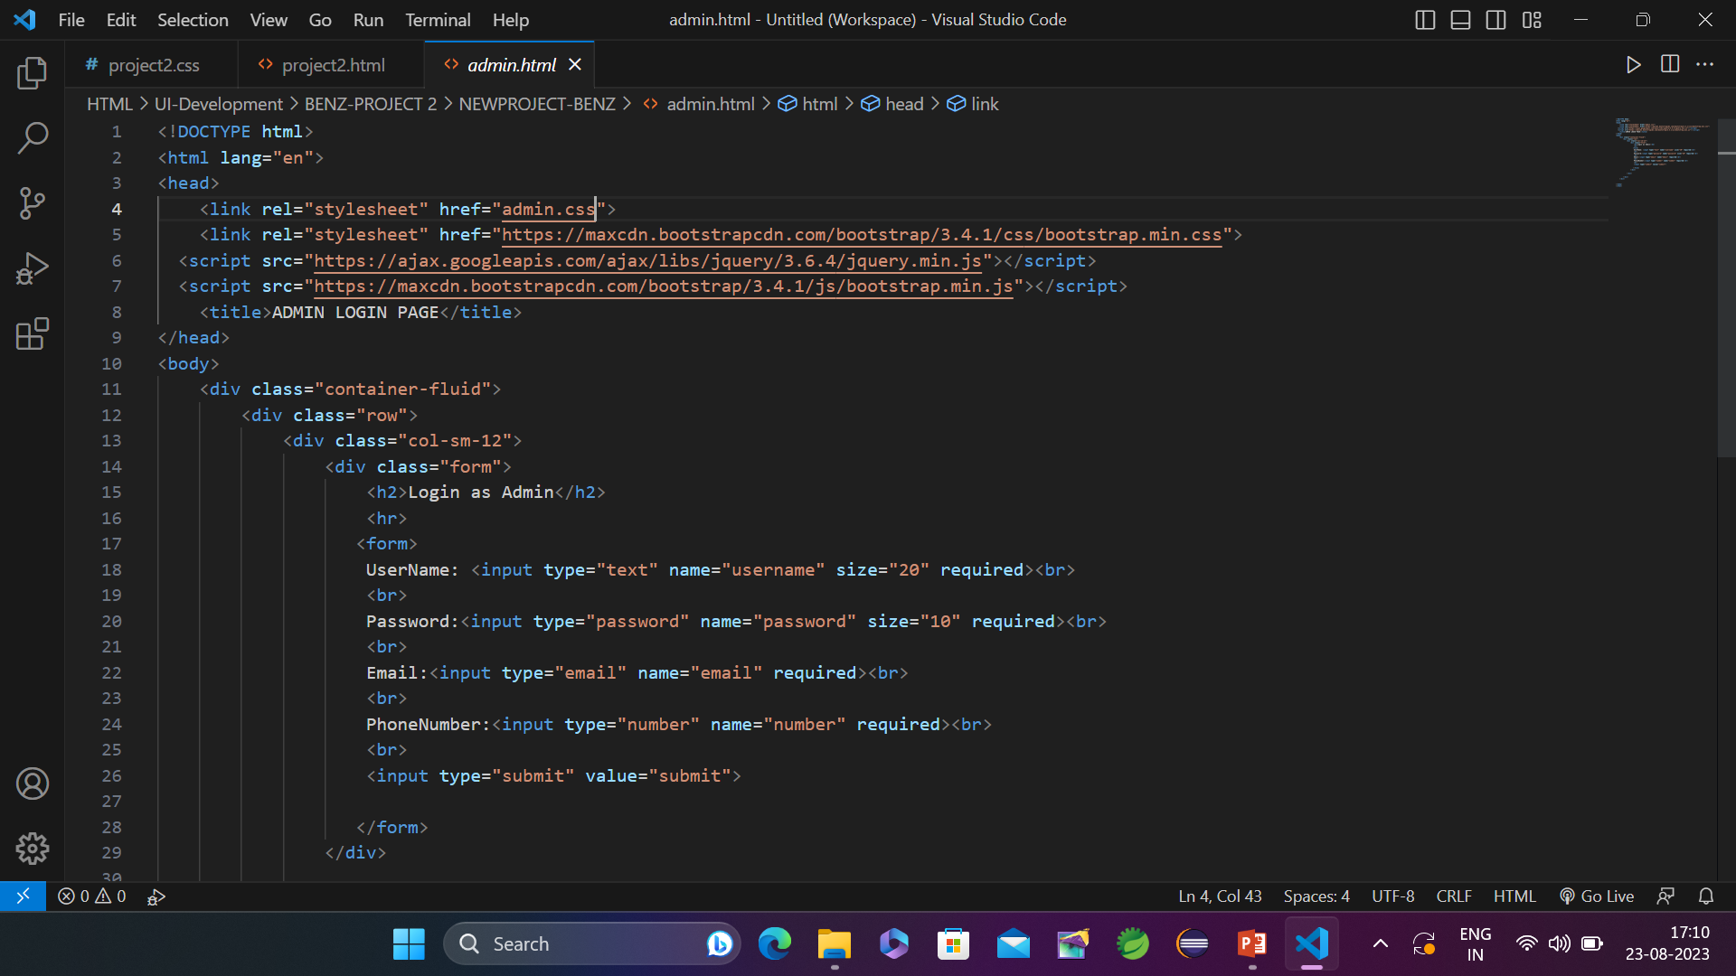
Login as Admin page HTML:
In the above Login1 form if we click on login as Admin it directs to this Admin page
Here, Below is the HTML Code for Amin page :

Slide 28
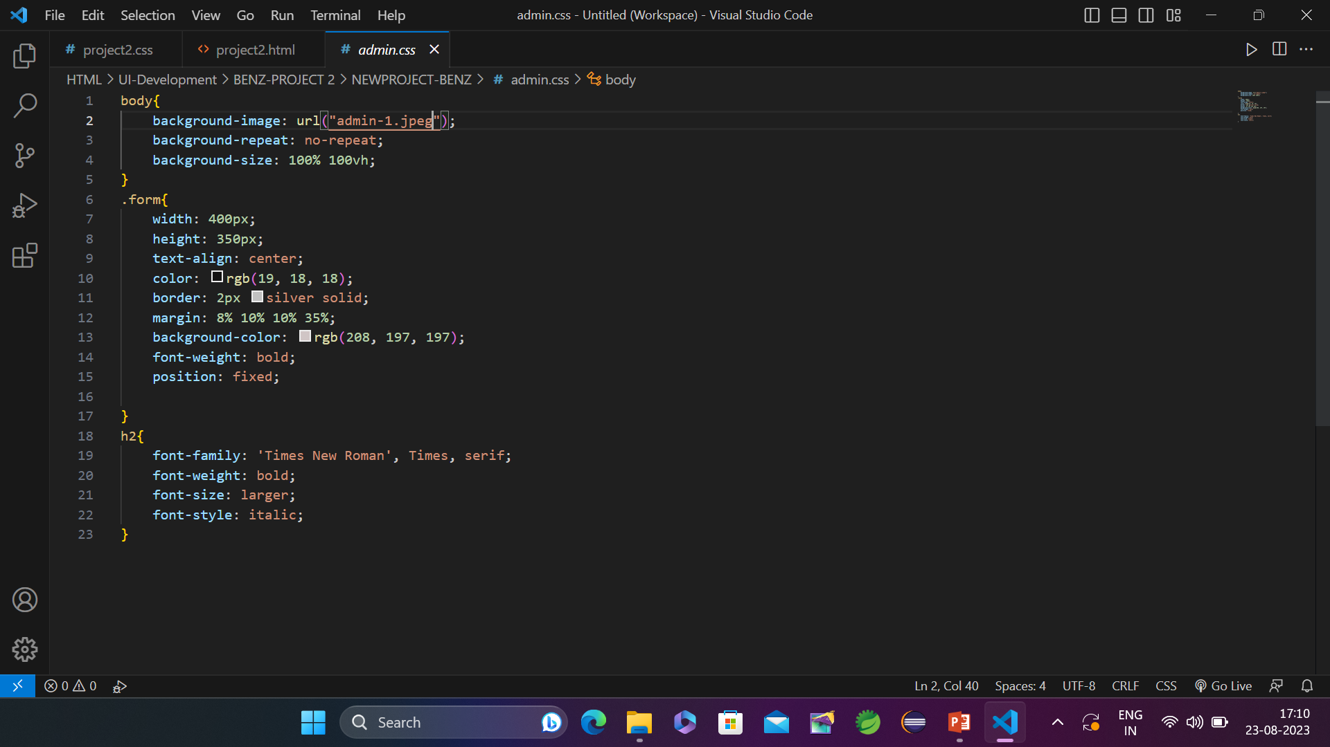
Admin css:

Slide 29
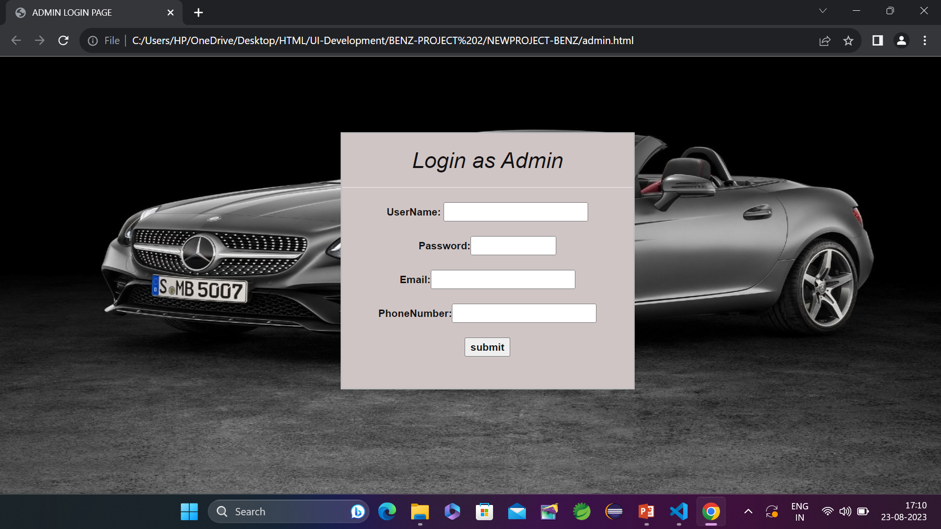
Output:

Slide 30
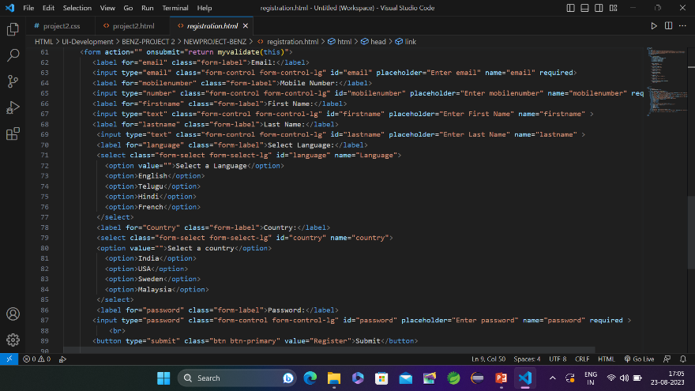
Registration page.html
In the above web page, if we click on register then it will directs the page to this registration
Here, below is the registration page :
-

Slide 31
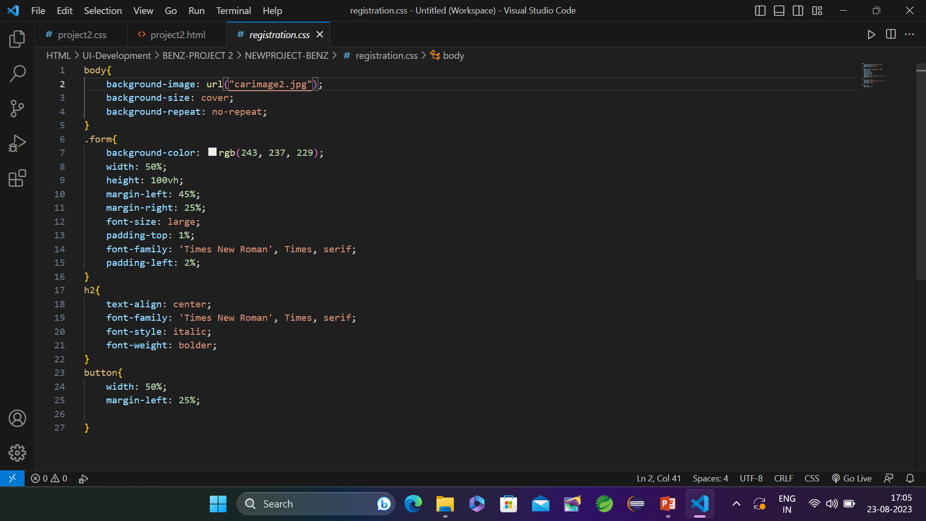
Registration page.css:

Slide 32
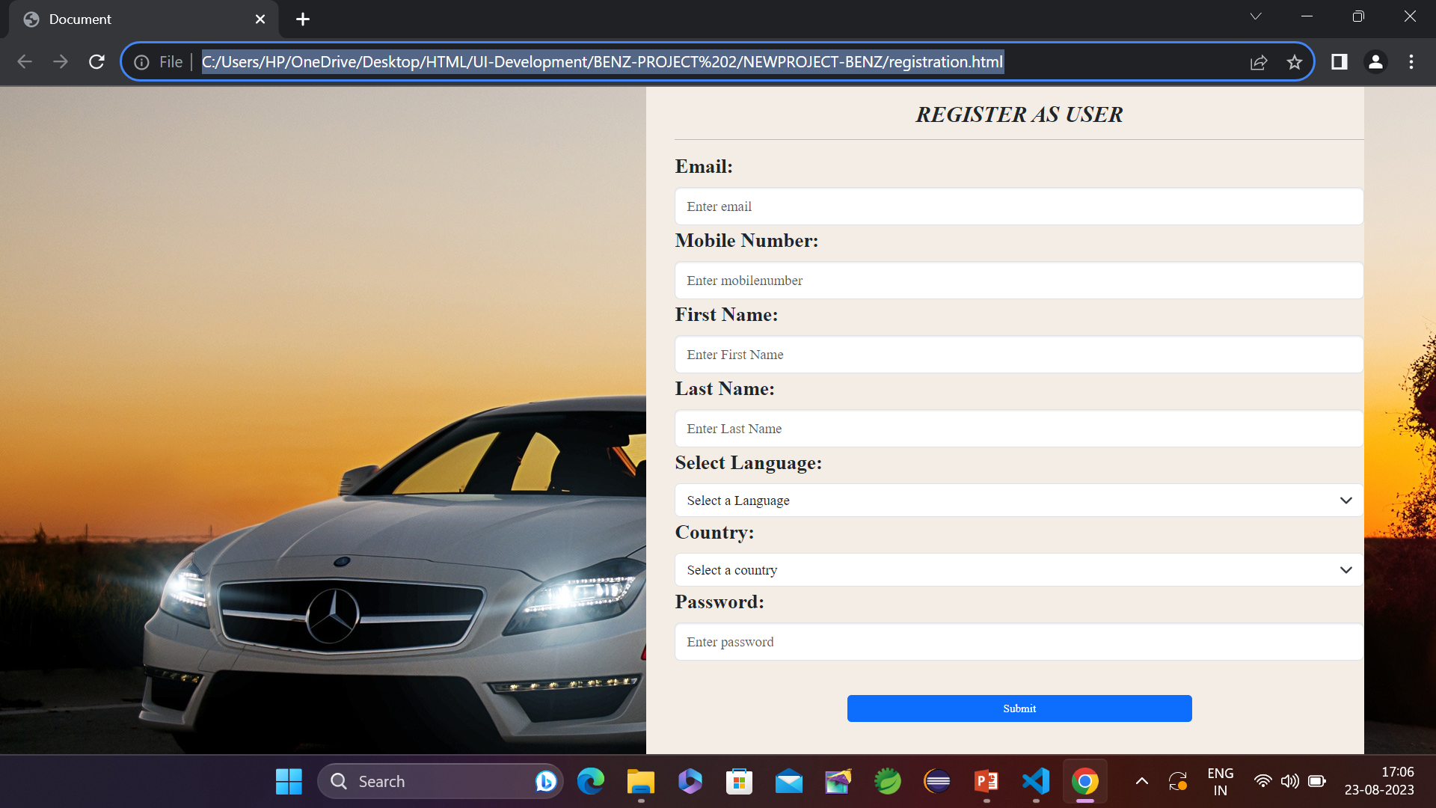
OutPut of registration page:

Slide 33
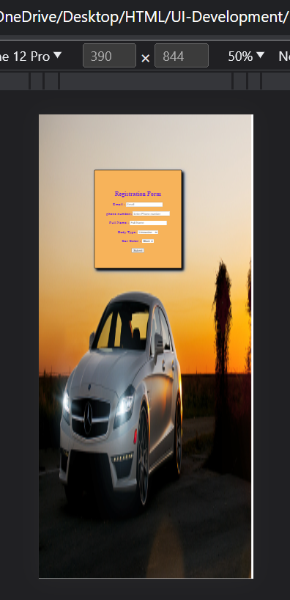
After applying media quires:
This is the output of Mobile view after adding media quires to Registration page:

Slide 34
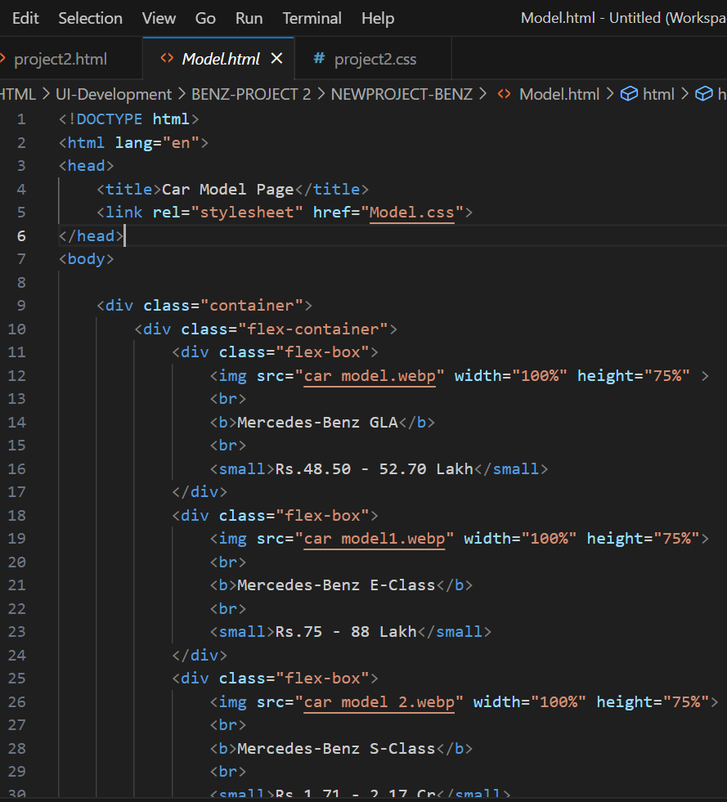
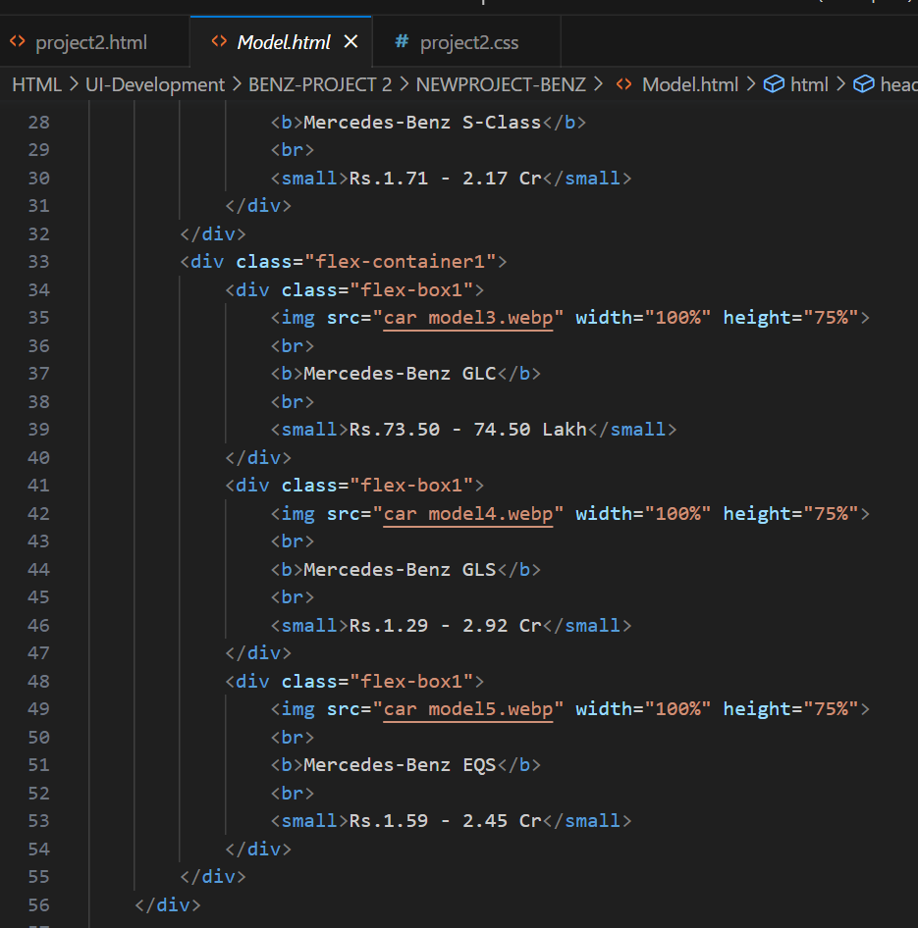
Model Page . Html:

Slide 35
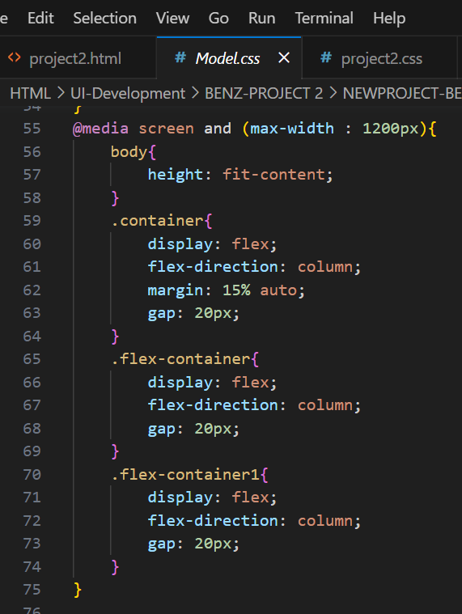
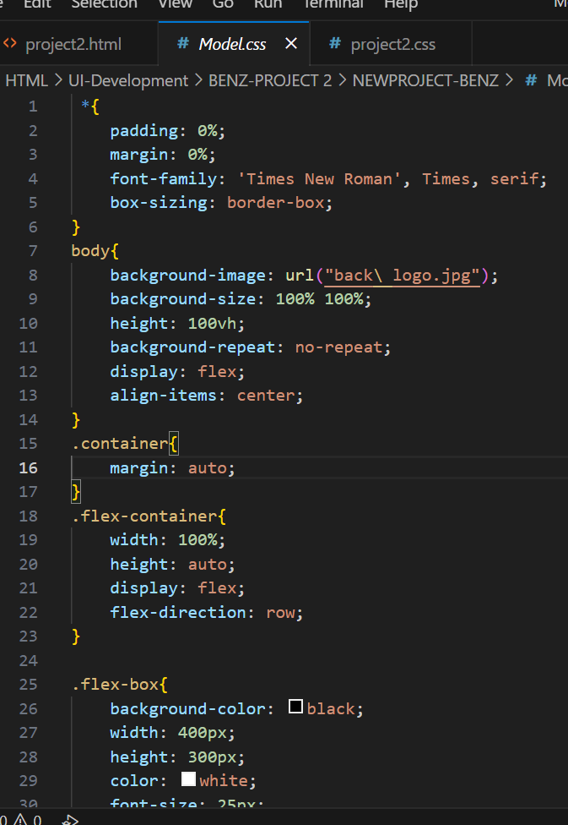
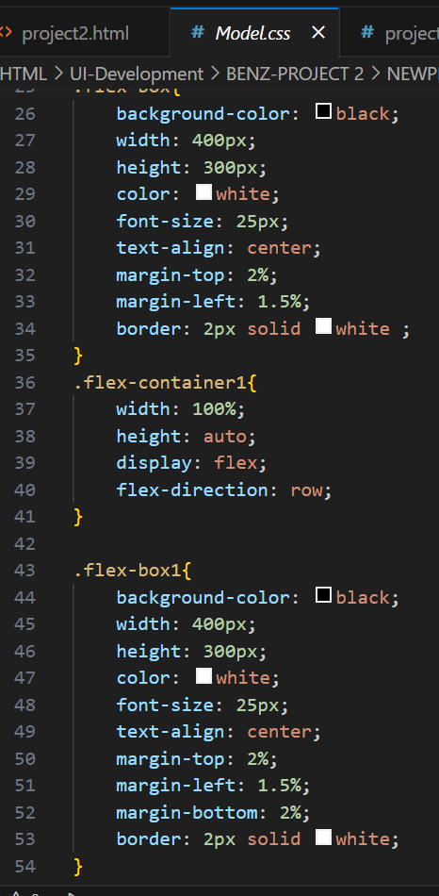
Model page . CSS :

Slide 36
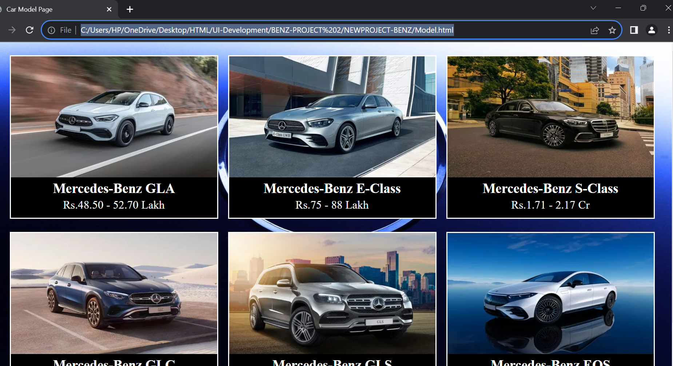
Output:

Slide 37
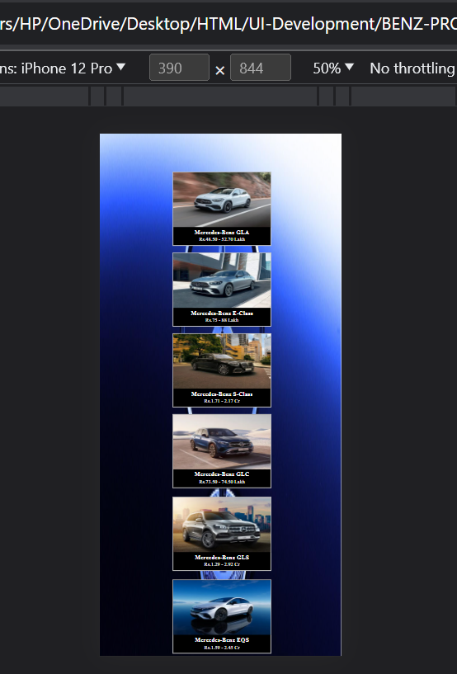
After adding Media quaries:
This is the output of Mobile view after adding Media quaires to Model page:

Slide 38
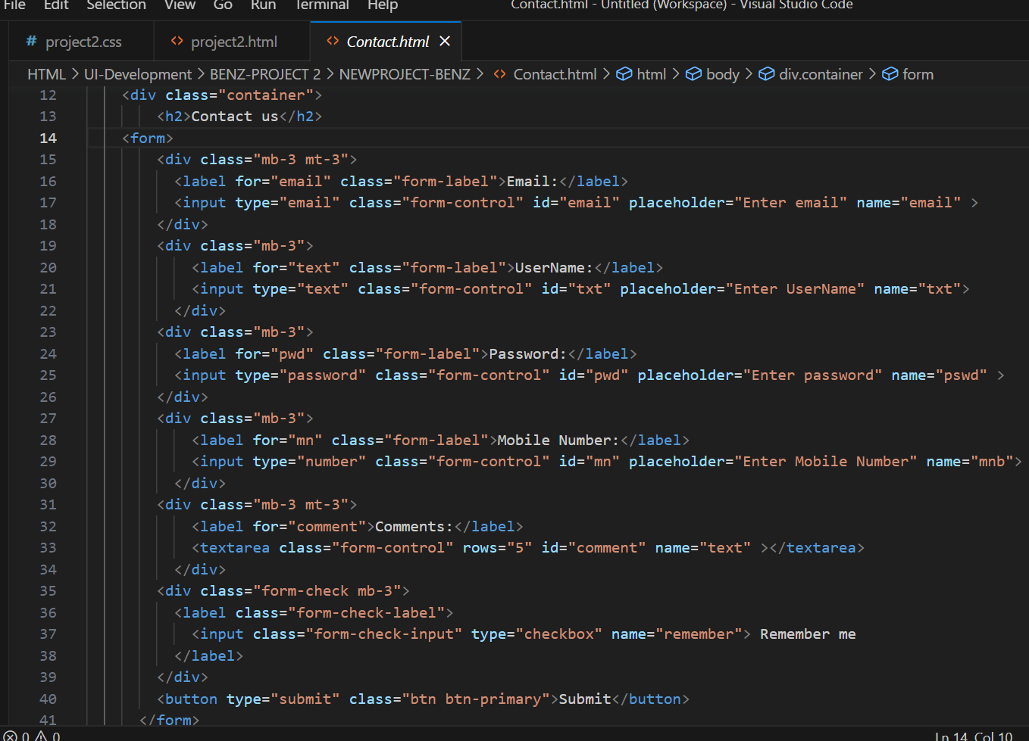
Contact Us Html page:

Slide 39
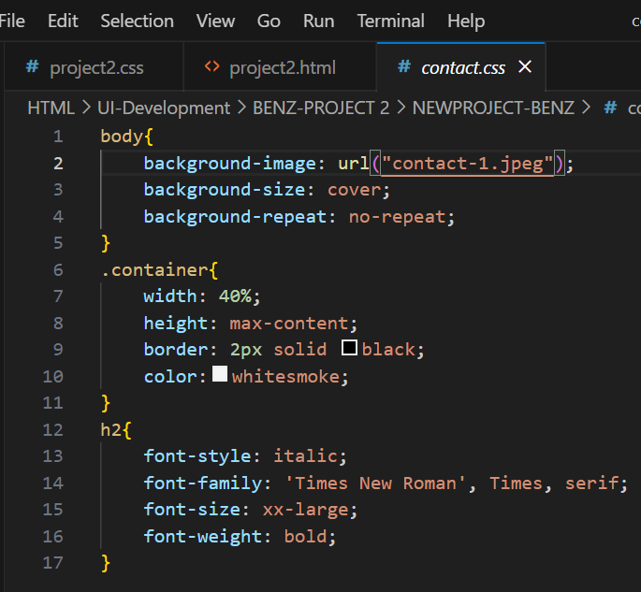
Contact Us css page:

Slide 40
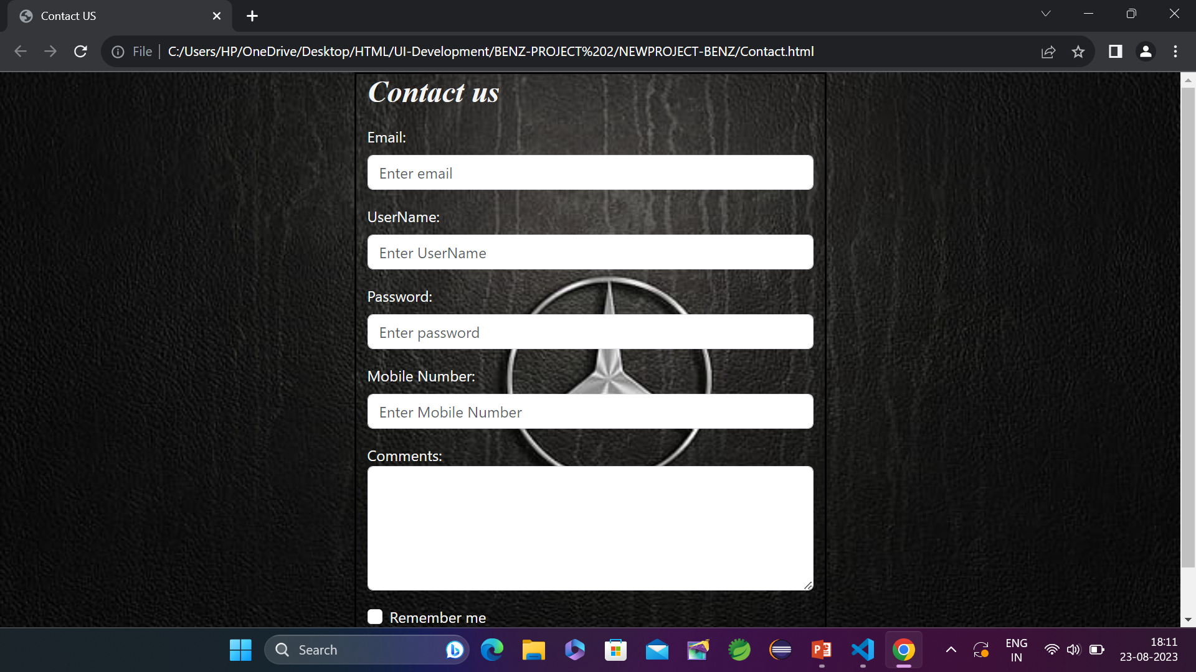
Contact Us Output page:

Slide 41
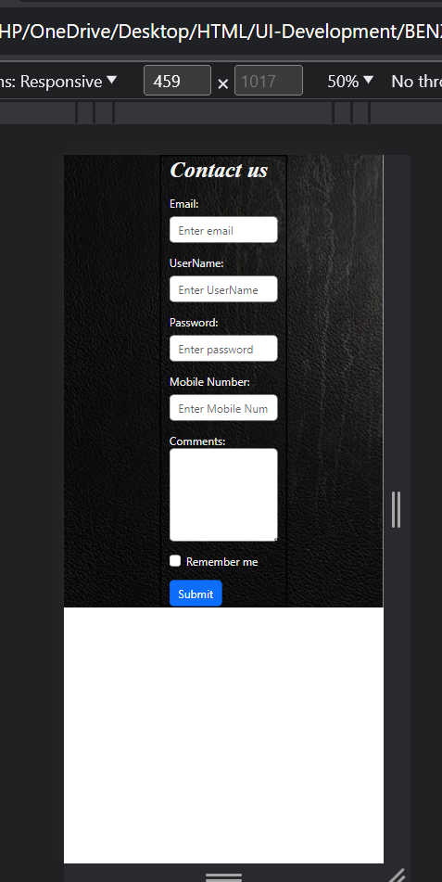
Contact Us page Mobile view:

Slide 42
-
THANK YOU

